Slide 1

Traffictelligence: Advanced Traffic Volume Estimation With Machine Learning
This presentation introduces Traffictelligence, an innovative AI solution for urban traffic optimisation. Our team combines diverse expertise to tackle complex mobility challenges.

Slide 2
Team Members(Team ID : LTVIP2025TMID44674)
Team Leader : Guntu Hima Bindu
Team member : Katakam Pavan Naga Sai Rama Karthik
Team member : Nune Sri Pavan Charan
Team member : Siliveri Venkatanarayana
Team member : Thunga Harshitha

Slide 3

The Problem: Inefficient Traffic Management
Current traffic management relies on costly manual counts and limited loop detectors. This leads to significant data gaps, contributing to an annual UK congestion cost of £6.9 billion. Static traffic light timings worsen the issue, increasing waiting times by 40% at peak hours.

Slide 4

Our Objective: Optimise Urban Mobility
Our primary objective is to achieve 95% accuracy in traffic volume estimation. This provides real-time data for dynamic traffic control, aiming to reduce congestion by 20% in pilot areas. Ultimately, we support data-driven planning and investment in urban infrastructure.

Slide 5
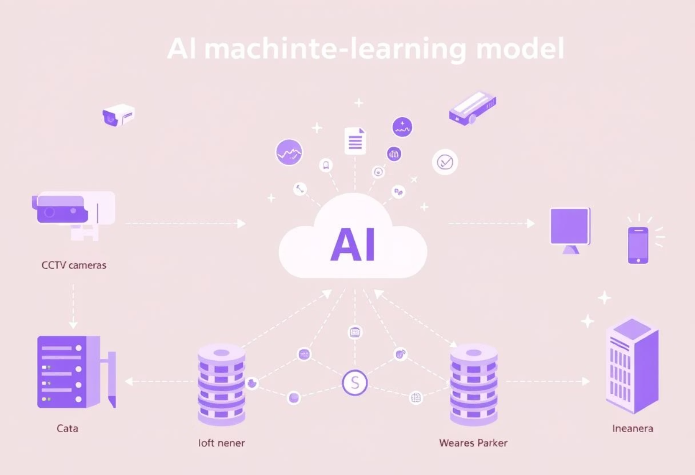
Proposed Solution: AI-Powered Estimation
Our solution leverages existing CCTV camera feeds and IoT sensor data. We employ advanced Machine Learning models, including Convolutional Neural Networks for vehicle detection. Long Short-Term Memory networks enable sophisticated predictive analytics.
The entire system operates on a cloud-native platform, ensuring scalable processing and data storage. An intuitive dashboard provides visual access to real-time and historical traffic data.

Slide 6




Key Skills & Expertise Required
Machine Learning
Python Development
Developing and deploying advanced machine learning models.
Core Python programming and web framework expertise.
Data Analysis
Data Visualization
Python for data analysis and preprocessing techniques.
Creating clear and impactful visual data representations.

Slide 7
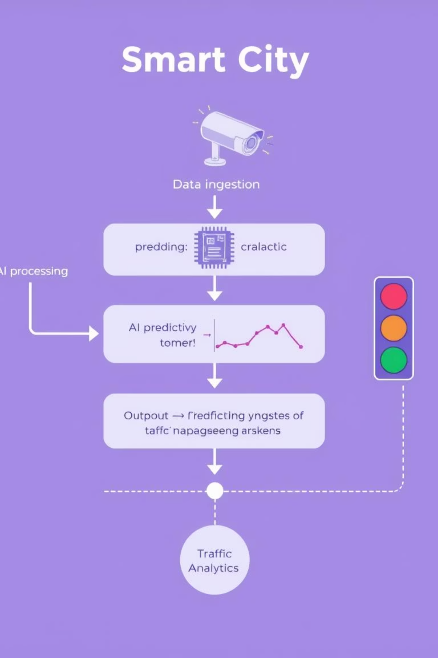
System Workflow: From Data to Decisions
Data ingests continuously from CCTV and IoT sensors, at 15 frames per second. AI processes this in real-time, achieving 98% object detection accuracy for vehicles. Predictive analytics forecasts traffic up to 60 minutes ahead with 90% confidence. A RESTful API ensures seamless integration with existing city traffic management systems.

Slide 8
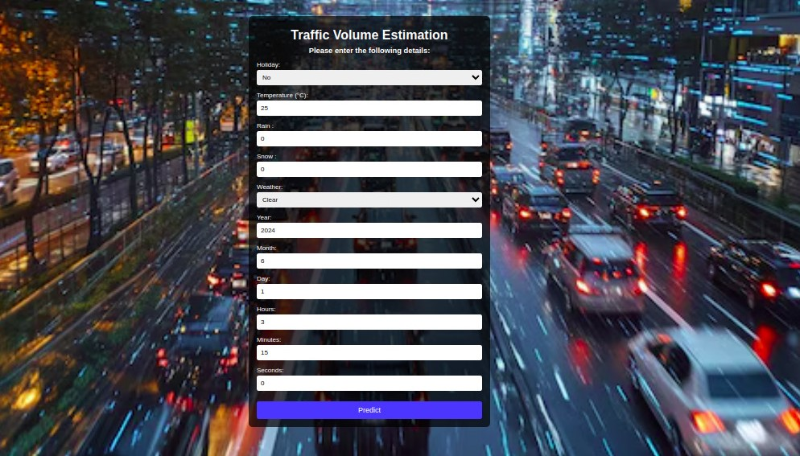
Input page

Slide 9
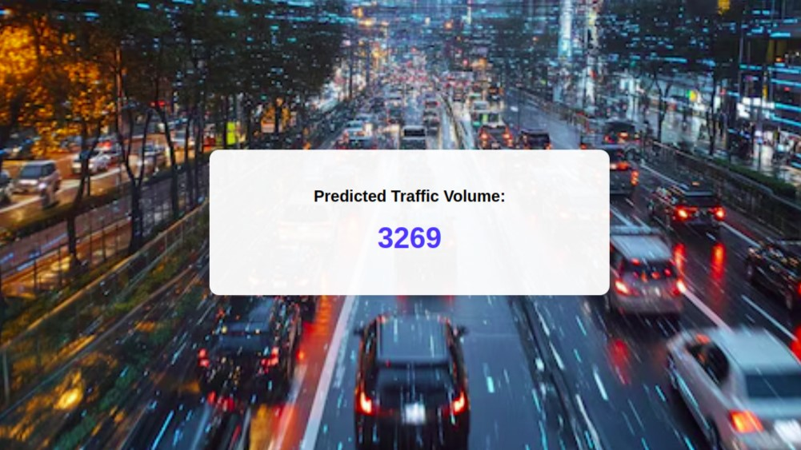
Output page

Slide 10
Target Users & Applications
City Councils
Highways Agencies
For urban planners and transport departments, optimising infrastructure upgrades.
Managing congestion, responding to incidents, and smart motorway operations.
Public Transport Operators
Emergency Services
Optimising bus routes and scheduling for improved efficiency.
Achieving dynamic routing to reduce response times by 10-15%.
Traffictelligence offers diverse applications across various public sectors.

Slide 11
Advantages & Disadvantages
Advantages
Disadvantages
High Accuracy: 95% compared to 70% manual methods.
Data Privacy: Concerns over CCTV usage and data handling.
Cost-effective: Utilises existing infrastructure, 75% cheaper.
Integration Complexity: Requires linking with legacy traffic systems.
Real-time Insights: Enables dynamic decision-making for traffic flow.
Environmental Factors: Performance impacted by adverse weather.
Scalability: Easily deployable across diverse urban environments.
Initial Investment: Upfront cost for AI model and cloud infrastructure.

Slide 12




Conclusion: Smarter Cities, Safer Journeys
Traffictelligence revolutionizes urban mobility by harnessing advanced AI and real-time data analytics. Our predictive approach empowers city planners, transport agencies, and emergency services to optimize traffic flow, reduce congestion, and build more efficient, safer, and sustainable urban environments.
Data-Driven Decisions
Reduced Congestion
Enhanced Safety
Real-time and predictive analytics empower informed planning and resource allocation for urban infrastructure.
Dynamic traffic control systems lead to smoother flow and significant reductions in travel times.
Optimized routes and incident response capabilities contribute to safer roads for all commuters.
Future-Proof Urban Planning
Equipping cities with the tools to adapt and grow sustainably in response to evolving mobility needs.

